Slide 1
Computer Hardware
Standard 1 - Objective 1: Demonstrate understanding of computer hardware, peripherals and troubleshooting

Slide 2
Computer Hardware
All the physical or tangible parts of a computer
Includes the electronic and mechanical devices that process the data; refers to the computer as well as peripheral devices. (Can be seen and touched)

Slide 3
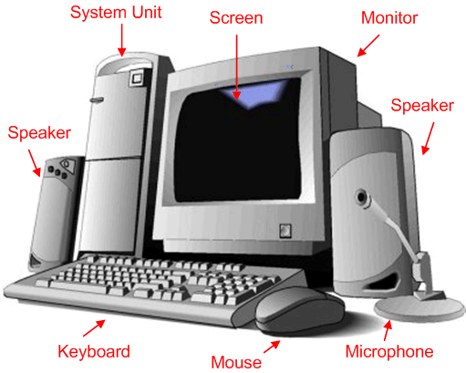

Slide 4
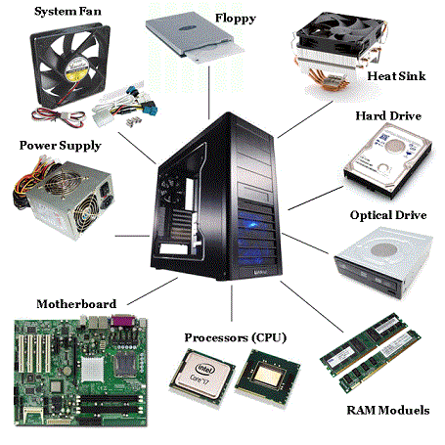

Slide 5
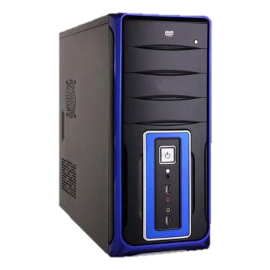
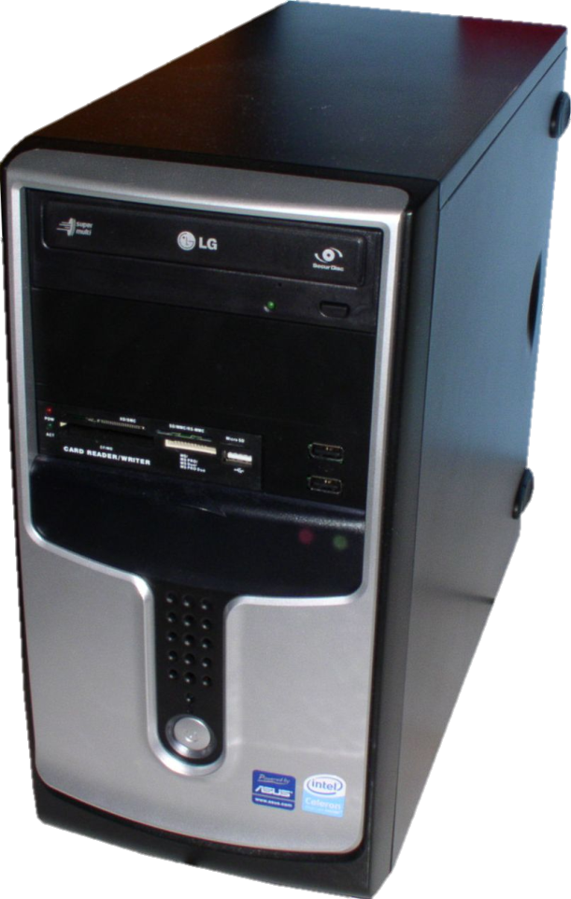
System Unit or Tower
Case that holds the power supply, storage devices, and the circuit boards (including the motherboard).

Slide 6
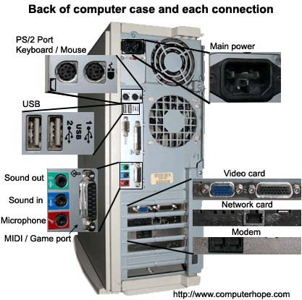

Slide 7
Motherboard
The central printed circuit board (PCB) of modern computers.
Holds many crucial components of the computer system.
Provides connectors for peripheral devices.
Sometimes known as the main board, system board, or logic board.

Slide 8
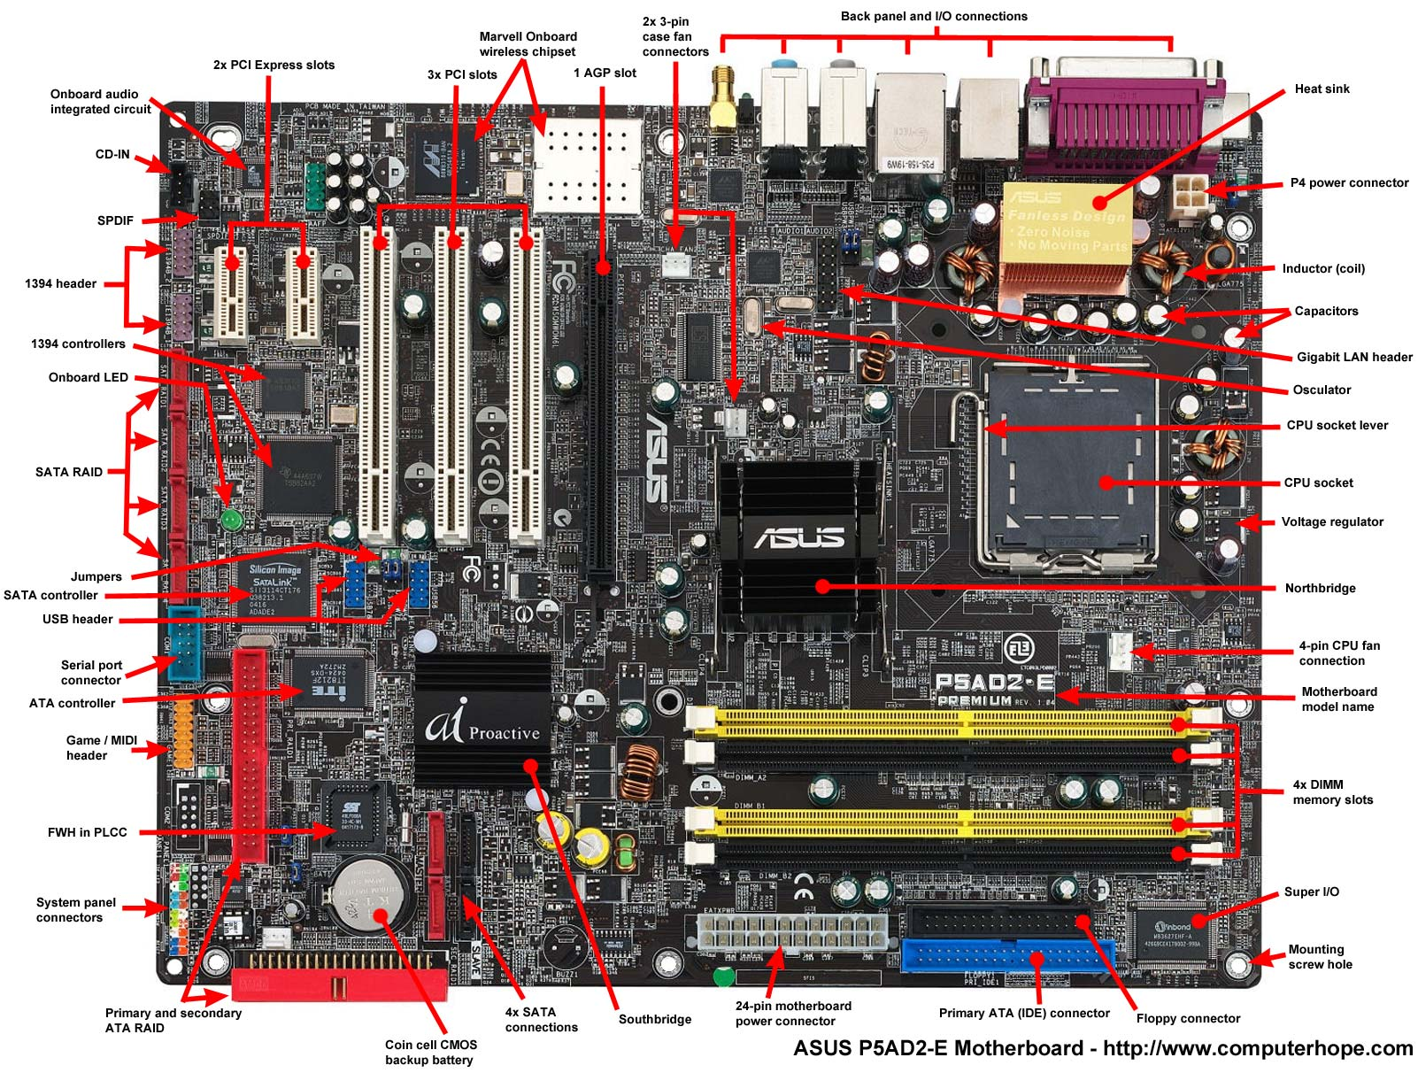

Slide 9
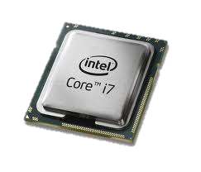
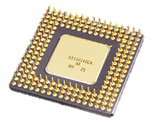
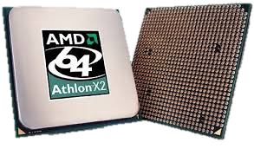
CPU (Central Processing Unit)
Where the processing in a computer takes place, often called the brain of the computer.

Slide 10
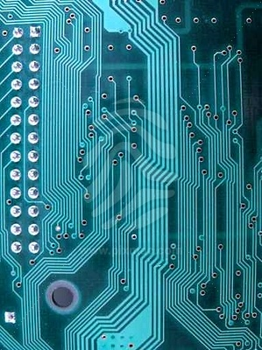
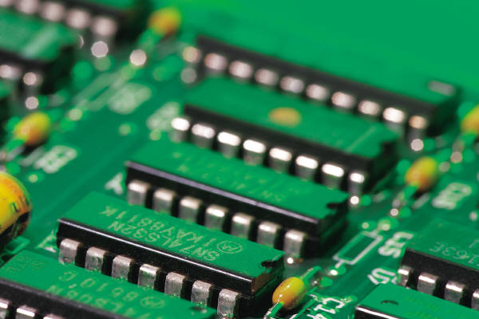
Circuits
The path from one component of a computer to another.
Data travels through circuits.
Circuits run between
  RAM and the microprocessor
  RAM and various storage devices

Slide 11
Silicon
Silicon is melted sand, and is what circuits are embedded into to keep them stable.

Slide 12
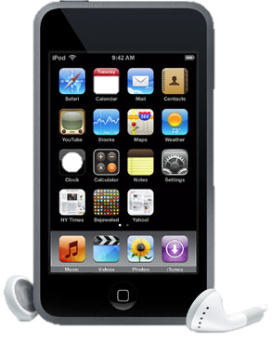
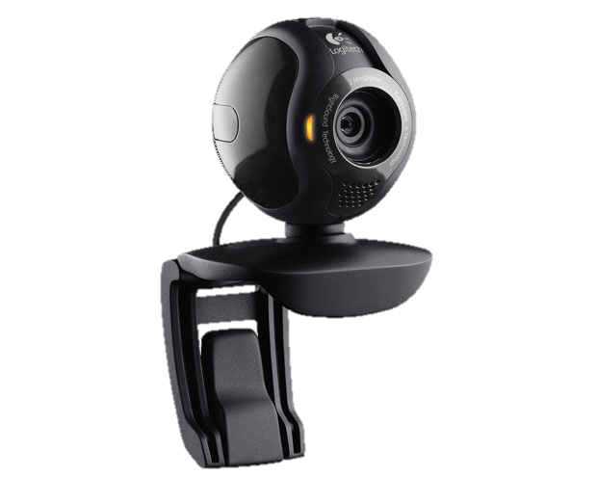
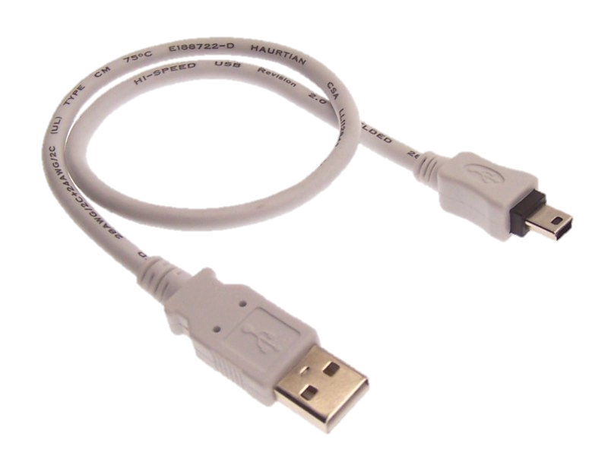
Peripheral devices
  Used to expand the computer’s input, output and storage capabilities.

Slide 13
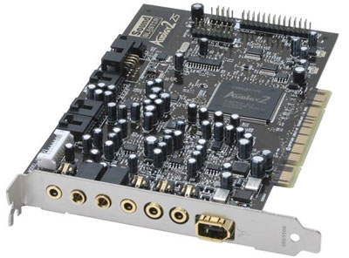
Sound Card
A circuit board that gives the computer the ability to accept audio input, play sound files, and produce audio output through speakers or headphones.

Slide 14
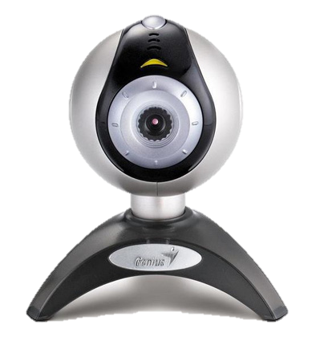

Input Devices
Units that gather and transform information into a series of electronic signals for the computer.

Slide 15
Keyboard
An arrangement of letters, numbers, and special function keys that act as the primary input device to the computer.

Slide 16
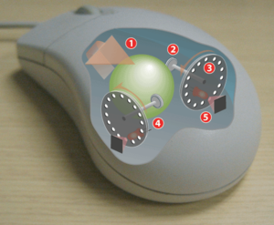
Mouse
An input device that allows the user to manipulate objects on the screen by moving the device along the surface of a desk.

Slide 17
Modem
A device that sends and receives data to and from computers over telephone lines or cables.

Slide 18
Output Devices
Devices that display, print, or transmit the results of processing from the computer’s memory.

Slide 19
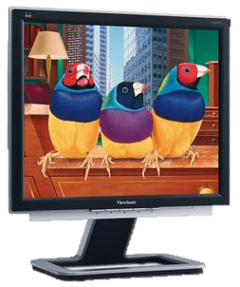
Monitor
Display device that forms an image by converting electrical signals from the computer into points of colored light on the screen.

Slide 20
Printer
Output device that produces text or graphical images on paper.

Slide 21
Speakers
Output devices that receive signals from the computer’s sound card to play music, narration, or sound effects.

Slide 22
Storage Devices
Used to keep data when the power to the computer is turned off.
Medium/media
  Place or Disk where data is stored. (Hard Disk, USB Drive, iPod, Floppy Disk, Ect.)

Slide 23
Magnetic Storage
Recording of data onto disks or tape by magnetizing particles of an oxide based surface coating.
A fairly permanent type of storage that can be modified.
Magnets, dust, liquid, etc. can damage your data

Slide 24
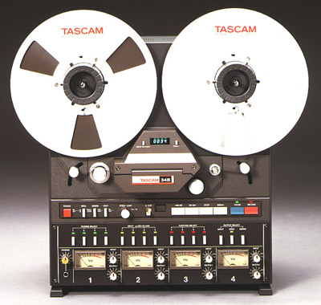
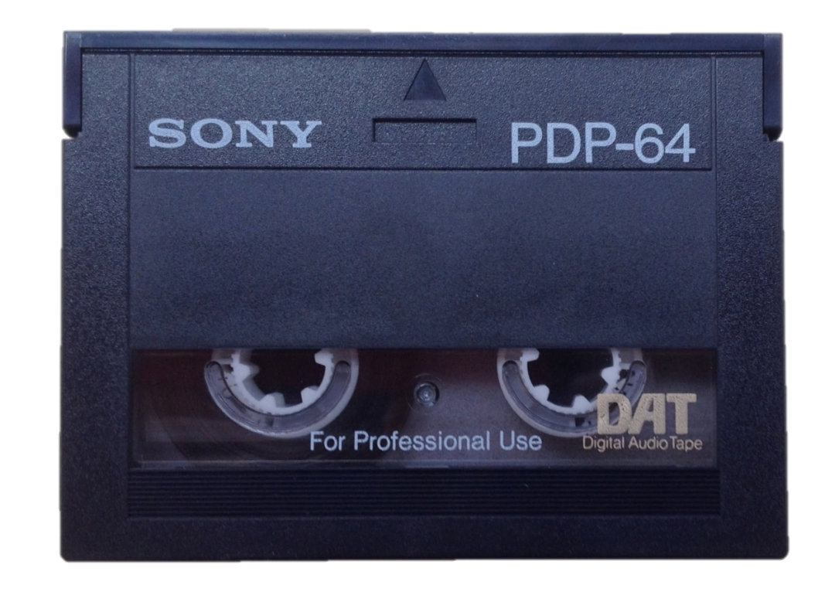
Digital Audio Tape
Method of storing magnetic data on tape.

Slide 25
Hard Disk/Drive
The main storage device for a computer
Usually mounted inside the computer’s system unit and connected to the Motherboard.
Can store billions of characters of data.
  Stated in forms of bytes:
    Megabytes, Gigabytes, Terabytes, Ext.

Slide 26
Floppy Disk
Round piece of flexible Mylar plastic covered with a thin layer of magnetic oxide and sealed inside a protective covering.
May be referred to as a “floppy”
3½ disk capacity is 1.44 MB or 1,440,000 bytes

Slide 27
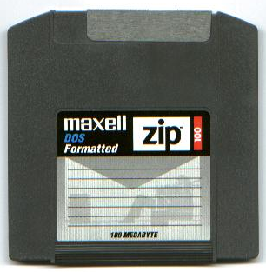
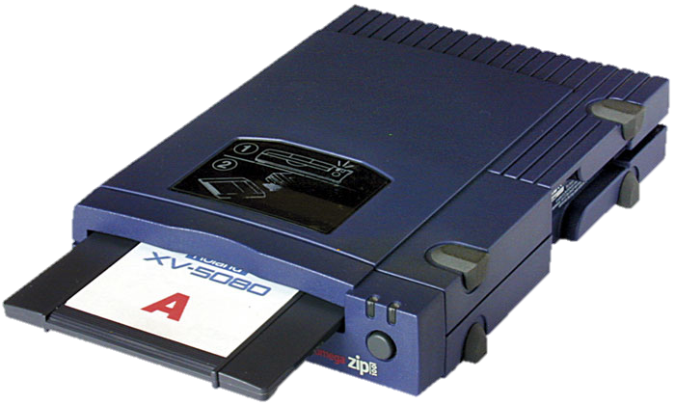
Zip Disk
Floppy disk technology manufactured by Iomega.
  Available in 100 MB and 250 MB versions

Slide 28
Optical Storage
Means of recording data as light and dark spots on CD, DVD, or Blu-ray Discs.
Reading is done through a low-power laser light.
  Pits
    Dark spots
  Lands
    Lighter, non-spotted surface areas

Slide 29
CD Drives
Compact Disc Drives
A storage device that can read and write data, from and to CD’s.
Similar to a CD-ROM, but has the ability to write to CD.

Slide 30
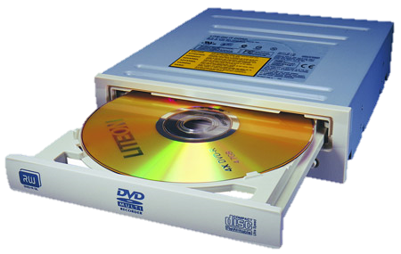
DVD Drives
“Digital Video Disks – Read Only Memory” (4.7 Gb)
Reads data from CD’s (audio and data) and DVD’s (data or movie)
Can be used to write data to a disk if DVD-RW.

Slide 31
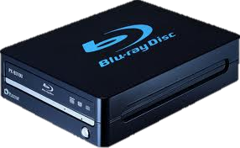
BD Drives
Blu-ray Disc Drives
Today you can purchase BD-RE which is Blu-ray Disc Recordable Erasable.
Blu-ray drives have all the functions of CD and DVD drives, but can store more data.

Slide 32
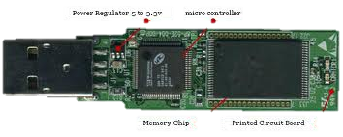
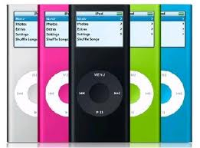
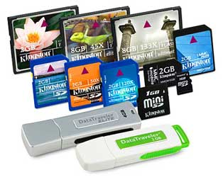
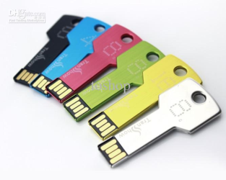
Flash Memory and Storage
Flash memory is electronic non-volatile computer storage technology.
Flash devices can be electrically erased and reprogrammed.

Slide 33
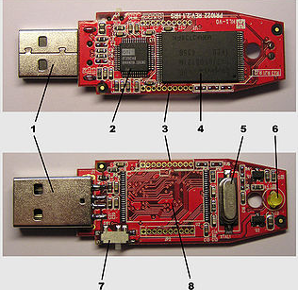
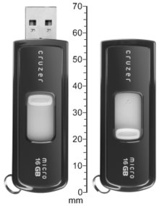
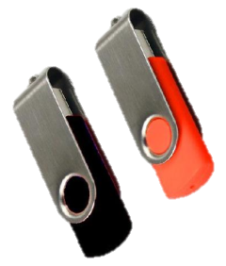
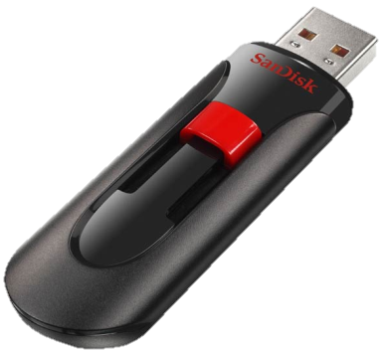
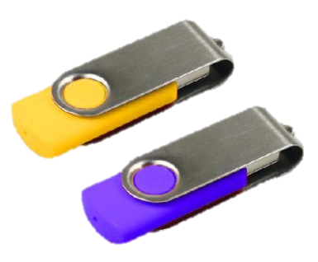
USB, Jump or Flash Drives
Replaced Zip and Floppy Disks
Because:
  Smaller—size of a key
  Faster-no bulky cables to hook up—inserts into USB port
  Cheaper—1 GB for about $6
1 – USB Connector
2 – USB Mass Controller Device
3 – Test points
4 – Flash memory chip
5 – Crystal oscillator
6 – LED
7 – Write-protect switch (Optional)
8 – Space for second flash memory chip

Slide 34
Cloud Storage
When storing data in the cloud or on the Internet, the data is actually stored on an organization’s servers.

Slide 35
Sources
1. Parsons, June Jamrich, and Dan Oja. Computer Concepts. Boston: Course Technology - Thompson Learning, 2002.
Contributors: Michelle Guymon, Kathy Knudsen, Julia Strangers, and Nathan Corry

