Slide 1
Setting Tab Stops in Microsoft Word
Tab stops allow you to insert text exactly where you want it to be in a Word document.

Slide 2
Open a New Word document
Save as Sample Tabs in Word Processing folder.
Go to next slide

Slide 3
Insert Ruler
You will need a ruler to insert tab stops
If the ruler is NOT visible:
Go to View, in the Show Group click Ruler

Slide 4
Alignment Button
There are 5 different types of tabs – left, center, right, decimal and bar.
To change from one tab to the next click the Alignment button.
Left Tab
Decimal Tab
Center Tab
Bar Tab
Right Tab

Slide 5
Setting Tabs
Set the following tabs on your Word document:
Left tab at 1”
Center tab at 3”
Right tab at 5”
To set left tab – make sure Alignment button has left tab then click on ruler at 1”
To set center tab – click Alignment button so center tab is showing then click on ruler at 3”
To set right tab – click Alignment button so right tab is showing then click on ruler at 5”
You ruler should look like the example below.

Slide 6
Setting Tabs continued
On your Word document type the following
Line 1: hit tab, type Country, tab, type City, tab, type Airport, hit Enter.
Line 2: hit tab, type United States, type New York City, type JFK, hit Enter.
Line 3: hit tab, type France, tab, type Paris, type Orly, hit Enter

Slide 7
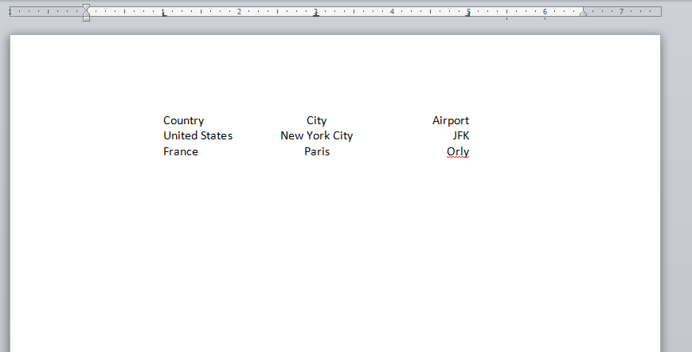
Your document should look like below

Slide 8
Deleting tabs
Hit enter so your insertion point is below the last line of your table.
Delete all 3 tabs.
On the ruler – click on a tab and drag straight down into document.
Do this for all 3. The ruler should now be clear.

Slide 9
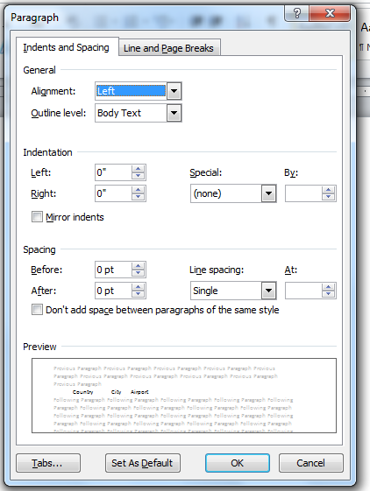
Setting tabs with leaders
Leaders are dots, dashes or underlines that help lead a reader’s eye across the page.
To set leaders you must go to the Tabs Dialog box.
Click on Home Ribbon
Click Paragraph
Click tabs (bottom left corner)

Slide 10
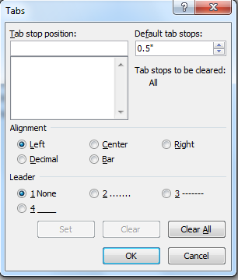
Tabs Dialog Box
The Tabs Dialog Box will open.
Set the following tabs using tabs dialog box:
Left tab at 1”
Right tab with dot leaders 5”
Type a 1 in tab stop position and click set.
Type a 5 in tab stop position, click right in Alignment and 2 in Leader and click set.
Click OK

Slide 11
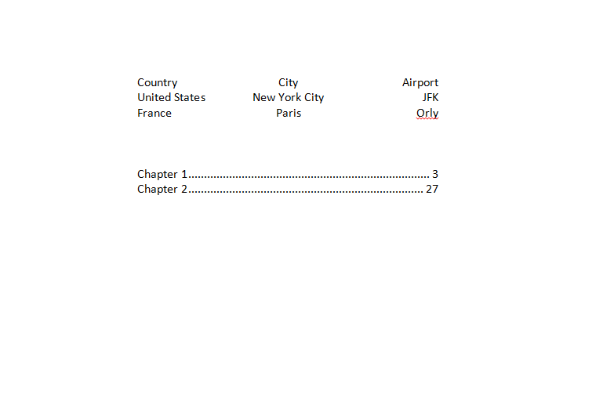
Tabs with leaders continued
On Word document – hit tab, then type Chapter 1, tab, 3, hit Enter
Hit Tab, type Chapter 2, tab, 27, hit Enter
You document should look like example below

